Slide 1

1. Component Models in Java
Mundtlig Eksamen
Patrick Hansen
pahan19@student.sdu.dk

Slide 2
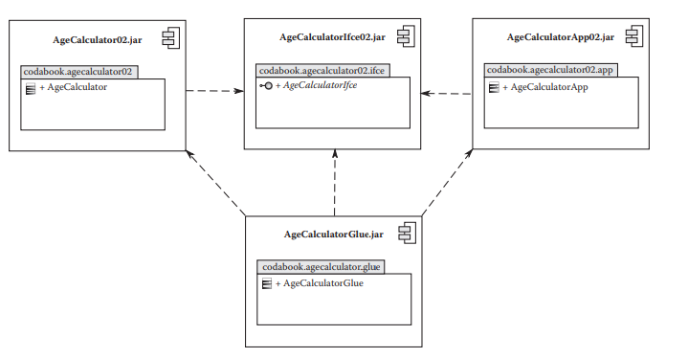
Hvad er et komponent?
Komponent
Karakteristika
Fordele
Brug
Interfaces
Glue kode
Notes:
Karakteristika
Et komponent baseret system kan samles og skilles ad.
Et sæt af relevant komponenter giver os et fuldt system
Komponent baseret system udvikles typisk som en samling af mindre dele
Fordele
Løse problemer vha. Separation of Concerns
Opdele ansvars områder
Genanvendelighed
Pick-and-choose
Maintainability (testing, udskiftning, videre udvikling, bug-fixing)
Normalt skal software integreres, men kan vi ikke samle det i stedet? Composition
Lav kobling vs høj kobling
Modules that know too much about other modules make changes hard to coordinate and make modules brittle. If Module A knows too much about Module B, changes to the internals of Module B may break functionality in Module A.
Brug
Interfaces giver os Dependency Inversion og Inversion of control.
Glue kode er en form for manuel assembly der kan ske automatisk med en component model

Slide 3
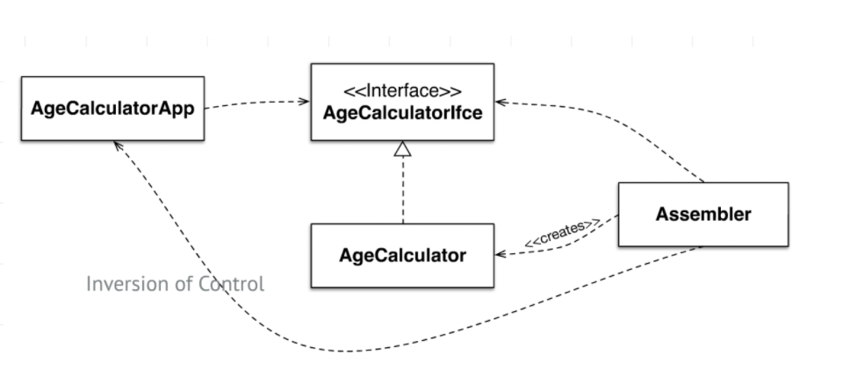
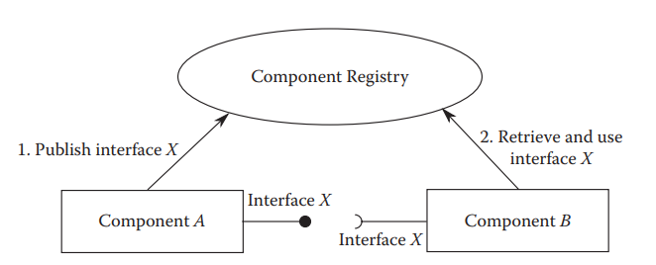
Komponent modeller
Dependency Inversion
Dependency Injection baserede modeller
Whiteboard
Registrering
Forespørgsel
Et par komponent frameworks
OSGi
Spring
NetBeans
Inversion of Control
Notes:
En component model er en standard der standardiserer mekanismerne til require/provide
## What are the different types of component models?
A component model is a definition of properties that components must satisfy, methods and mechanisms for the composition of components
### Dependency injection-based component models
Inversion of Control
Separate what-to-do part from when-to-do part.
Ensure that when part knows as little as possible about what part; and vice versa.
Dependency Inversion
Moduler afhænger af abstraktioner (interfaces)
Each component declares the set of interfaces provided by it and the set of interfaces required by it.
- The component framework analyzes this information on all the deployed components and injects the providing component references to requiring components
### Publish and consume whiteboard query-based component models
Each component registers the set of provided interfaces with a whiteboard registry.
- Any component requiring an interface queries the whiteboard registry to obtain a reference to the providing component.

Slide 4

Spring Frameworket
Notes:
Adskiller sig ved ikke at have interfaces som eksplicit krav. Beans.xml kigger bare i hierarkiet.

Slide 5
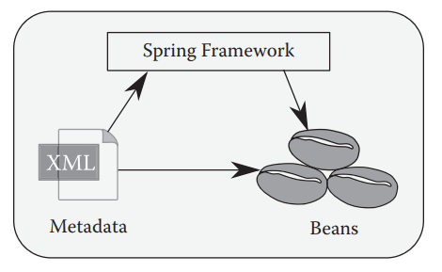
Spring containeren
Kernen af frameworket
Adskillige ansvarsområder
Wiring
To typer af container
BeanFactory
ApplicationContext
Notes:
### Spring container
The Spring container is the core of the Spring framework, and has the following responsibilities:
- instantiating components
- configuring properties of components
- wiring them together as per dependency injection information specified
- completely managing the life cycle of components from their creation through destruction
The container depends on a configuration to decide on which components to instantiate and how to wire.
- Is built on the principle of IoC
- Uses dependency injection/whiteboard to manage the components deployed in them
> The Spring container is of two types
#### Spring `BeanFactory` container
The simplest container, an implementation of the Factory design pattern.
- Provides basic support for dependency injection
- Is defined by an interface called the `BeanFactory` interface in the Spring API
> Preferred for simple lightweight applications
#### Spring `ApplicationContext` container
ApplicationContext API kan bruges til Whiteboard
Enhanced container that includes all the functionality of the `BeanFactory` container, provides additional enterprise functionality.
Provides several classes for loading bean definitions from the configuration file, through:
- The File system: `FileSystemXmlApplicationContext`
- The CLASSPATH: `ClassPathXmlApplicationContext`
- A Web application: `WebXmlApplicationContext`

Slide 6
Spring beans
To typer
Singleton (default)
Prototype
Notes:
Spring components are referred to as _Spring beans_ and play the role of business components in the Spring framework
Developed and deployed in the Spring Container, which manages their life cycles.
Managed by the container with the help of the configuration file
Spring beans are POJOs and are categorized into two types only at the time of instantiation:
- Singleton (default)
- Only a single instance of the bean is created per Spring container
- Cached and used for subsequent requests
- Prototype
- Any number of instances can be created based on the requests
> Bean type is specified in the bean definition configuration file

Slide 7
Spring konfiguration
Tre måder at konfigurere på
XML
Annotations
Java
Metadata
Id, class, name
scope, init-method
Beans.xml
<?xml version="1.0" encoding="UTF-8"?> <beans xmlns="http://www.springframework.org/schema/beans" xmlns:xsi="http://www.w3.org/2001/XMLSchema-instance" xsi:schemaLocation="http://www.springframework.org/schema/beans http://www.springframework.org/schema/beans/spring-beans.xsd"> <!-- Player Beans --> <bean id="PlayerBean" class="dk.sdu.mmmi.cbse.playersystem.Player" /> <bean id="PlayerControlSystemBean" class="dk.sdu.mmmi.cbse.playersystem.PlayerControlSystem"/> <bean id="PlayerPlugin" class="dk.sdu.mmmi.cbse.playersystem.PlayerPlugin"/> <!-- Asteroid Beans --> <bean id="AsteroidControlSystemBean" class="dk.sdu.mmmi.cbse.asteroid.AsteroidControlSystem" /> <bean id="AsteroidPluginBean" class="dk.sdu.mmmi.cbse.asteroid.AsteroidPlugin" /> <!-- Collision Beans --> <bean id="ColliderBean" class="dk.sdu.mmmi.cbse.collision.Collider" /> </beans>
Notes:
## What is the significance of the Spring configuration?
It's critical for managing bean instances
Spring provides three configurations:
- XML-based configuration file (most popular)
- Can have any name, but is usally named `Beans.xml`
- Contains configuratino metadata used by the container creating a bean instance, managing the bean's life cycle methods, and managing the bean's dependencies
- Annotation-based configuration
- Java-based configuration
Some of the important metadata that are part of the configuration file:
- **id**
- id for the bean
- **class**
- Specifies the bean class
- **name**
- alias name for the Id of the bean
- **scope**
- scope of the bean objects: singleton, prototype
- **lazy-init**
- bean will be initialized only during the first request
- **init-method**
- method invoked after initialization of the bean
- **destory-method**
- method invoked before the destruction of the bean instance
- **constructor-arg**
- used for injecting dependencies
- **properties**
- used for injecting dependencies
- **autowire**
- used for injecting dependencies
Spring adskiller sig
Har i sig selv ikke noget koncept af interfaces, men kigger i hierarkiet indtil den finder en implementering

Slide 8
Portefølje eksempel
private ApplicationContext context = new ClassPathXmlApplicationContext("Beans.xml");
private Collection<? extends IGamePluginService> getPluginServices() { return context.getBeansOfType(IGamePluginService.class).values(); } private Collection<? extends IEntityProcessingService> getEntityProcessingServices() { return context.getBeansOfType(IEntityProcessingService.class).values(); } private Collection<? extends IPostEntityProcessingService> getPostEntityProcessingServices() { return context.getBeansOfType(IPostEntityProcessingService.class).values(); }

Slide 9
OSGi Frameworket
Løsningen på Javas modularity problem
Bedre kontrol af kodestrukturen
Bedre kontrol af objekters livsscyklus
Arkitektur der har lav kobling, og høj samhørighed

Slide 10
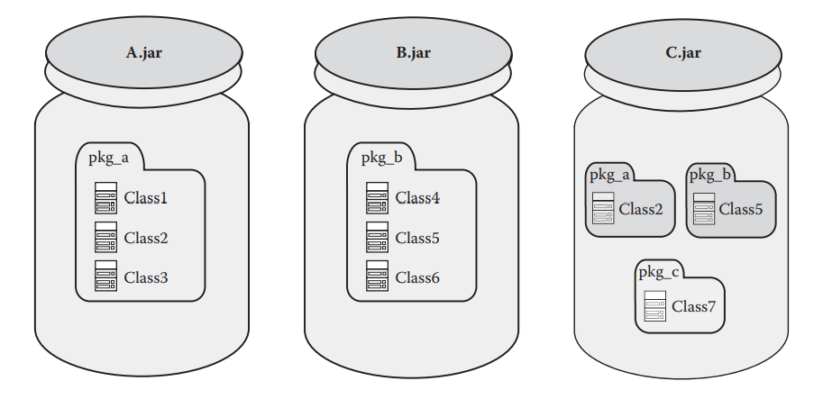
Problemet med Jar fil-baseret komponent model
Problemet med JAR fil-baseret komponent model
Flad classpath (præcedens!)
Komponent grænser ”opløses” ved runtime
Adfærd ændrer sig, runtime miljø bestemmer
OSGi’s Module layer er løsningen!

Slide 11
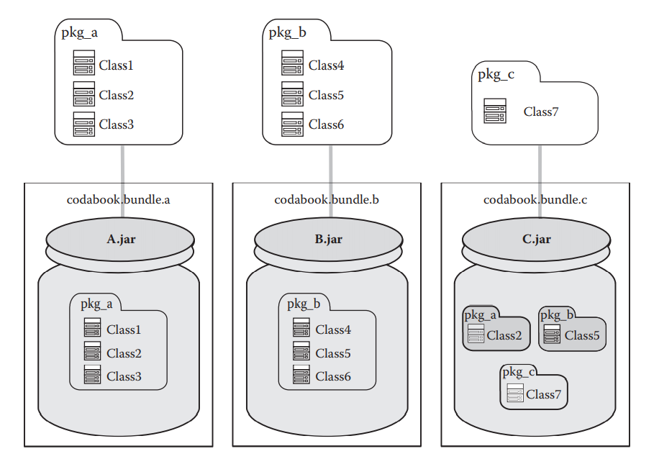
OSGi Module Layer (Bundles)
OSGi’s ”enhed”
Normal JAR fil…?
Eksplicit eksponering af pakker
Stærkere grænser
Erklæres i META-INF/MANIFEST.MF og fortolkes af OSGi frameworket
Identitet
Notes:
## 3. Are all OSGi bundles JAR files?
Yes
It is:
- a regular JAR file that contains
- class files
- resource files
- metadata
- special because
- it carries additional metadata relevant to OSGi in the manifest of the JAR file
- `META-INF/MANIFEST.MF`
Loades indenfor class loading context of a bundle (sæt ned i noter)
Billedet
Alle pakkerne fra A.jar og B.jar er eksporteret eksplicit og tilgængelige til alle andre bundles.
C.Jar gør kun Class7 tilgængelig, og Class2 og Class5 loades inden for bundle contexten og er dermed ikke synlige udenfor. Det er fordi at pakkerne ikke er blevet eksporteret eksplicit og komponenterne kan altså ikke forstyrre hinanden uanset runtime miljø
OSGi Identitet
The symbolic name and version together uniquely identify a bundle
Bundle-SymbolicName: org.package.uniqueName
Bundle-Version: x.y.z.qualifier
Two bundles can only share the `Bundle-SymbolicName` if their `Bundle-Version` differs

